Slide 1
Robots as Agents
CS 245
CS 245 – Robotics and Machine Learning

Slide 2
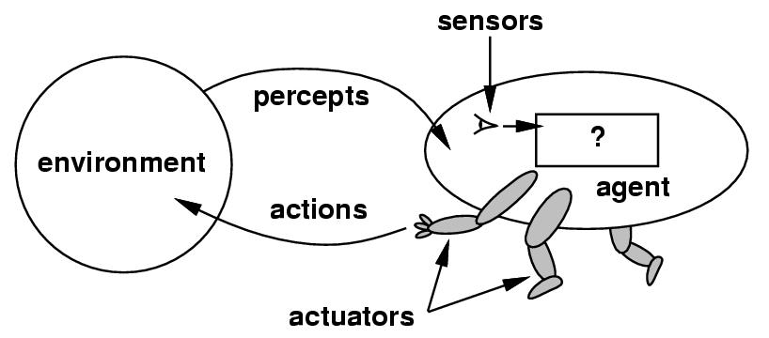
Agents and Environments
Agent
  Perceiving its environment through sensors and acting upon that environment through actuators
  Percepts and Percept Sequences
    Agents actions (in general) can depend on the entire percept sequence
  Agent’s behavior is described by the agent function that maps any given percept sequence into an action.
  Robots are usually agents
CS 245 – Robotics and Machine Learning

Slide 3
Rationality
Rationality depends on
  The performance measure
  The agent’s prior knowledge of the environment
  The actions that the agent can perform
  The agent’s percept sequence up to date
Rational behavior: doing the best thing with given information
  Best thing = that which is expected to maximize performance measure
  Not omniscience, not (necessarily) perfection
CS 245 – Robotics and Machine Learning

Slide 4
Omniscience, Learning, and Autonomy
Omniscient agent
  knows the actual outcome of its actions
  impossible in the real world
  Rationality maximizes expected performance
  Perfection (omniscience) maximizes actual performance
Learning
  Prior knowledge is augmented through experience
  Do we need prior knowledge?
  What if the environment is known a priori?
  What if the environment is not known?
CS 245 – Robotics and Machine Learning

Slide 5
Autonomy
Autonomy
  Agent should learn how to compensate for incorrect or partial prior knowledge
  Complete autonomy form the start is seldom required
  So, agent should have some initial knowledge as well as the ability to learn
CS 245 – Robotics and Machine Learning

Slide 6
The Structure of Agents
Job of AI
  Design an agent program that implements the agent function mapping percepts to actions
    Really? Is that all AI does?
  Program runs on some sort of an architecture
Agent = architecture + program
  Agent program takes the current percept, while agent function takes entire percept sequence
    Agent program needs to “remember” the percepts
  Table-driven agents are the simplest
    However, not practical (table sizes)
  Goal:
    Produce rational behavior with small amount of code rather than from large amount of table entries
CS 245 – Robotics and Machine Learning

Slide 7
The Structure of Agents
Idealized classes
Simple reflex agent
Model-based reflex agent
Goal-based agent
Utility-based agent
  All agent types can be made to learn
Learning Agents
CS 245 – Robotics and Machine Learning

Slide 8
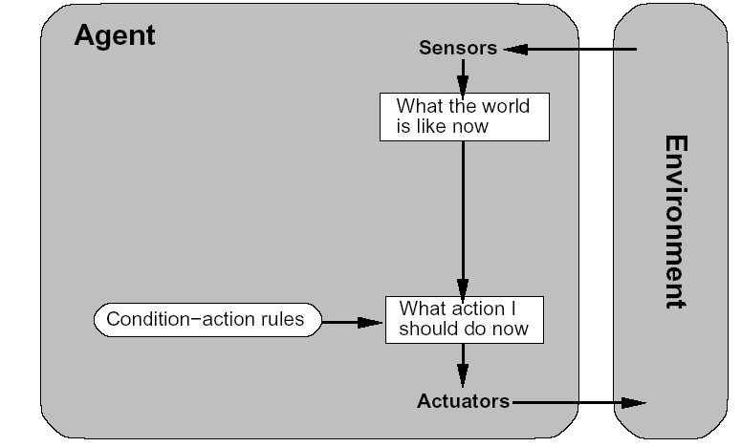
Simple Reflex Agent
  Makes decisions based on current percept only
  No memory
  Problems if environment is not fully observable
  Condition-action rules
    A generalization; may not be literally a set of rules, but still behaves this way
  Infinite loops
    Sometimes avoided
    with randomization
CS 245 – Robotics and Machine Learning

Slide 9
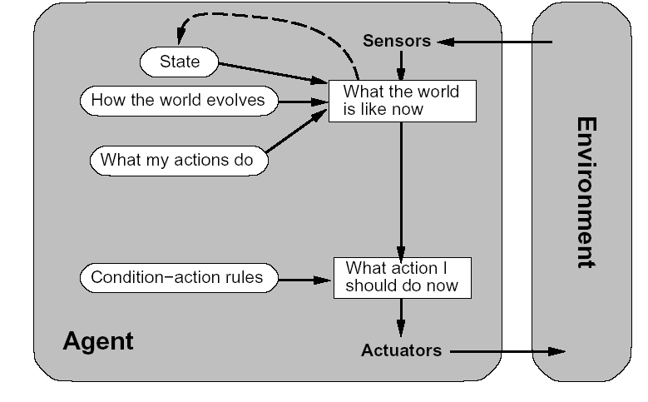
Model-Based Reflex Agent
One way to deal with partial observability:
maintain an internal state
To keep internal state current, need
  a model of the way the world works, and
  a model of the way the agent’s actions affect the world
CS 245 – Robotics and Machine Learning

Slide 10
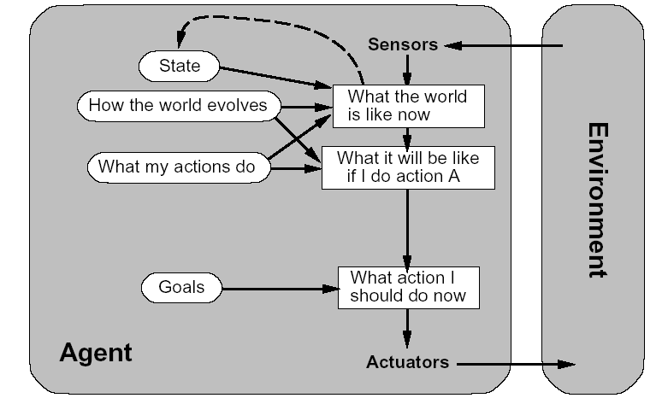
Goal-Based Agent
Goals represent desirable states
  Agent chooses actions that maximize chances of reaching goal(s)
  Sometimes achieving a goal requires sequences of actions: search, planning
  A goal-based agent is more flexible than a reflex agent
  A reflex agent’s rule
  set is for a particular,
  implicit goal; the set
  must be replaced if
  the goal changes
CS 245 – Robotics and Machine Learning

Slide 11
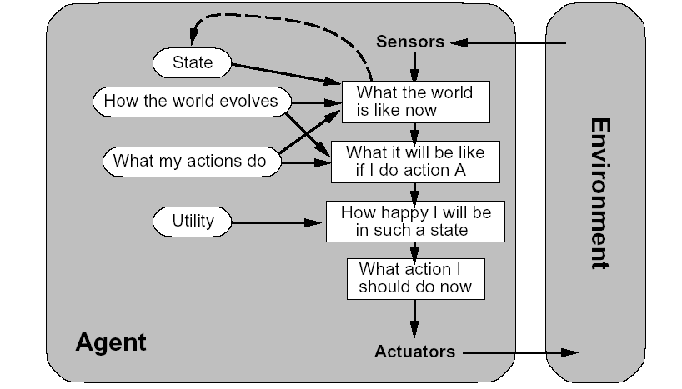
Utility-Based Agent
Utility = degree of happiness
  Goals are just target states. What if…
    Some goals are conflicting?
    Not all goals can be reached with certainty…which are the important ones?
  A utility function maps a state into a real number (the utility) that is the desirability of that state
CS 245 – Robotics and Machine Learning

Slide 12
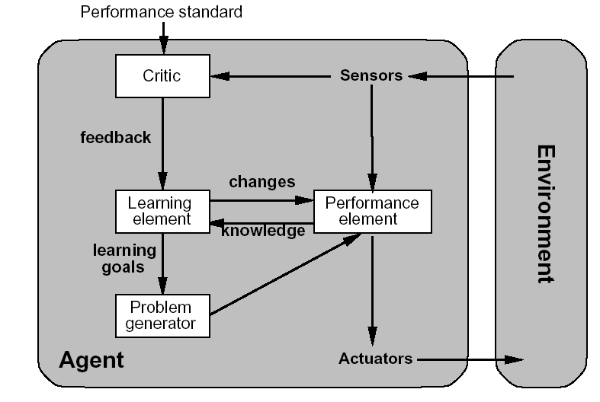
Learning Agents
Learning element
  Responsible for making improvements
Performance element
  Selects actions
Critic
  Provides feedback
  Performance Standard:
    Reward/Penalty from
    percepts
Problem generator
  Explores
CS 245 – Robotics and Machine Learning

